Slide 1
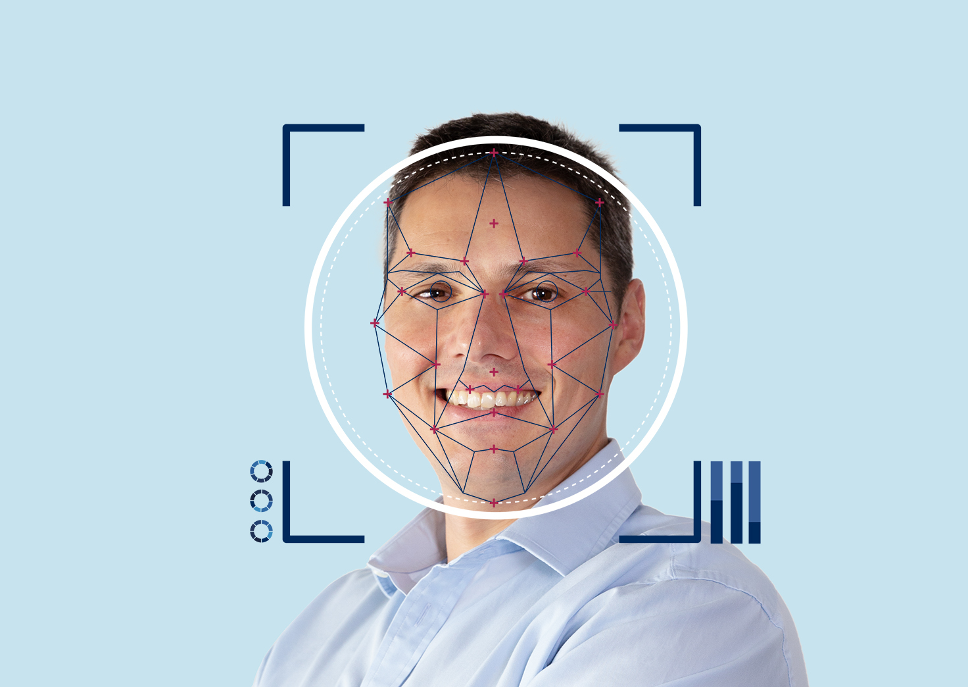
Facial Recognition
Tim. E. Doughery, Chenhao Lu, Seho Chung

Slide 2
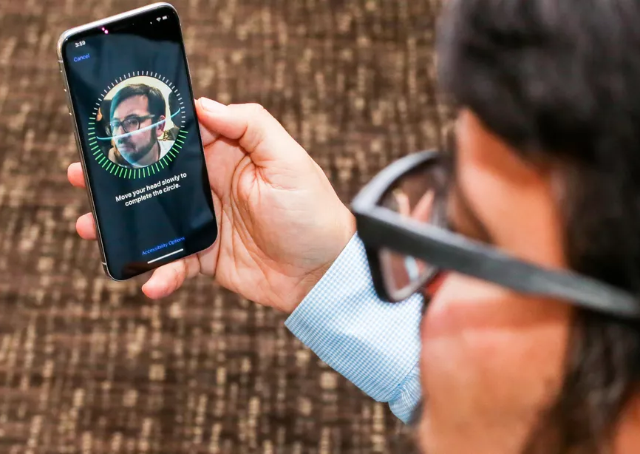
Problem description
Facial recognition can be found being used in many places, from the phone in your hand, to even within the government. One of the more famous implementations of this is Google’s facenet, which many projects hope to emulate or use.
Purpose: To understand how one can make a reliable model.

Slide 3
Challenges
Data science and Artificial Intelligence has emerged to a greater extent to solve many complex problems
The pandemic introduces issues to traditional Facial recognition because of the user wearing masks
Obtaining quality dataset of facial images with masks and transforming them into the right shape and size is one of the key challenges of this project
Learning and classifying facial data is one of the key elements required to build the intelligence

Slide 4
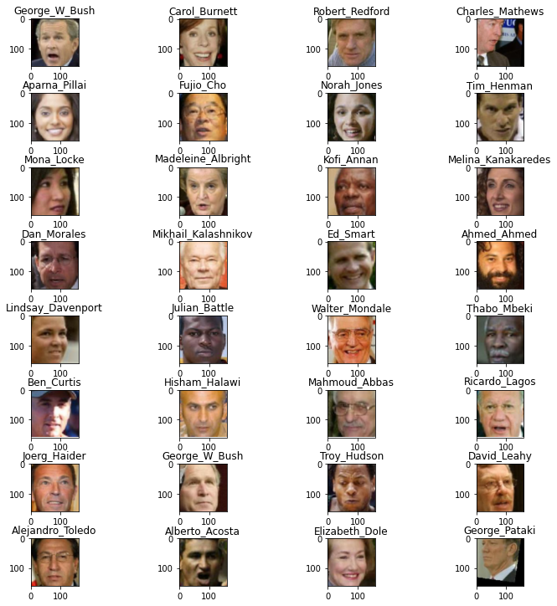
Datasets
One batch of dataset
Based on Labelled Faces in the Wild (LFW) from University of Massachusetts Amherst
LFW-deepfunneled
13,233 images of 5749 different people
Faces are already pre-aligned so that the eyes and noses are in the same position
LFW-masked
Train: 13047 images of 5713 people
Test: 90 images of 48 people faces
LFW-mixed
26,348 images of 5749 different
faces masked & unmasked

Slide 5
The Approach
The model: Google’s FaceNet for extracting embeddings, linear SVC for classification
Structure of program
Preprocessing
Embedding Extraction
Classification

Slide 6
Preprocessing
OpenCV Haar Cascade face detector
If failed to find faces, crop the center of the image
Resize the image to (160, 160)
Embeddings Extractions
Pretrained keras FaceNet model by https://github.com/nyoki-mtl/keras-facenet
Outputs 128-dimensional embedding for every input image
Compiled using triplet loss
Normalized using Scikit-learn normalizer with L2-norm
Classification
Scikit-learn LinearSVC

Slide 7
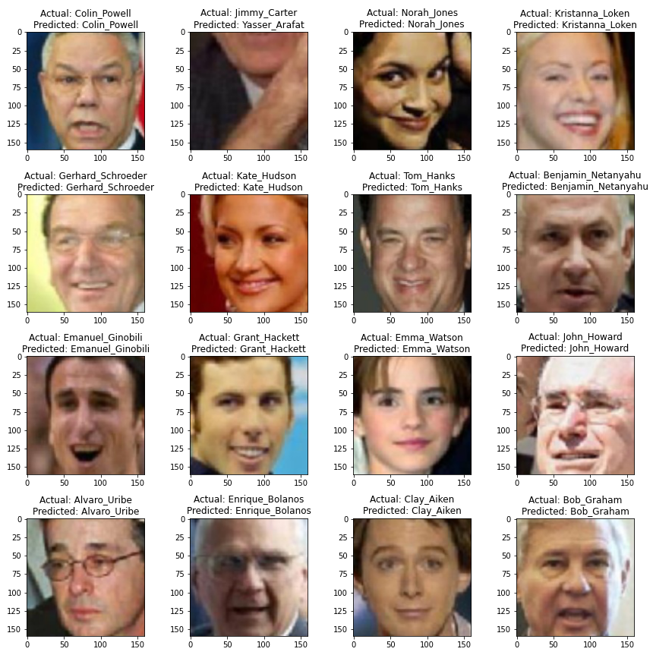
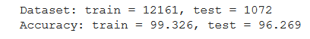
Results on base LFW

Slide 8
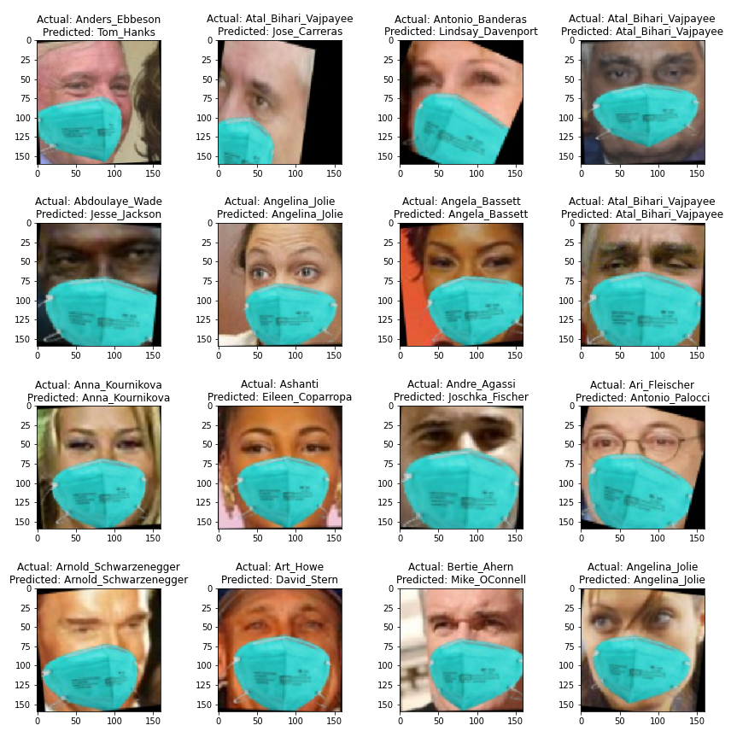
Results on masked LFW when trained on unmasked only

Slide 9
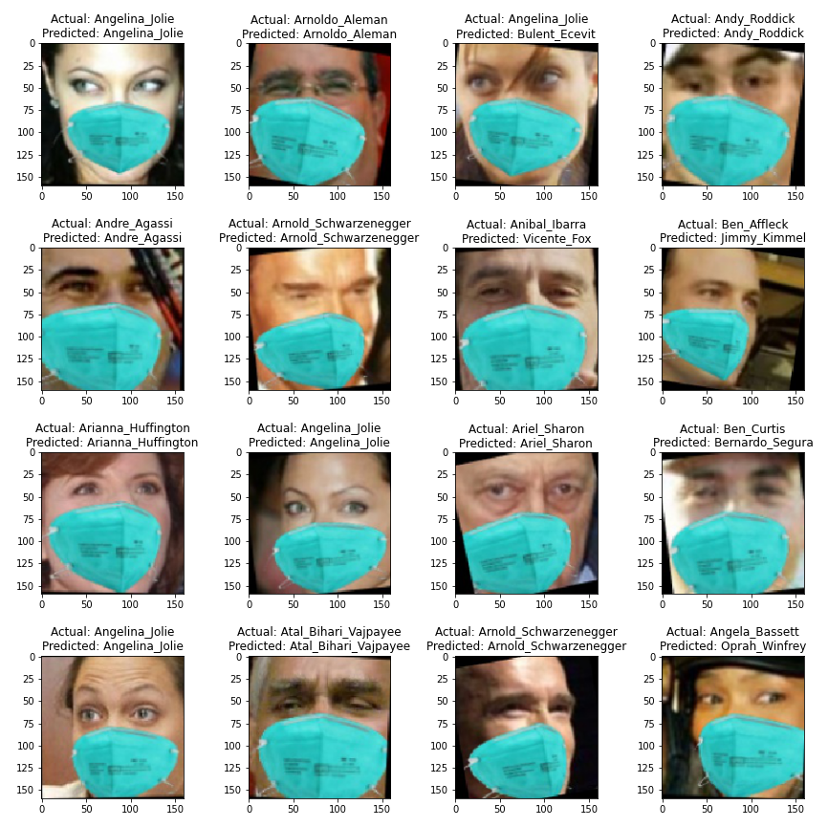
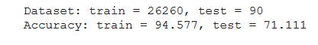
Results on masked LFW when trained on the mixed set

Slide 10
Discussion
While we didn’t achieve a completely reliable model, we were able to come close and create a useable model.
We didn’t expect complete accuracy on masked faces. Masks simply obscure too much of the face.
Masks are also identical, which may confuse the model.
To increase accuracy, we could’ve added data augmentation to increase samples for the model to learn from.

